Slide 1



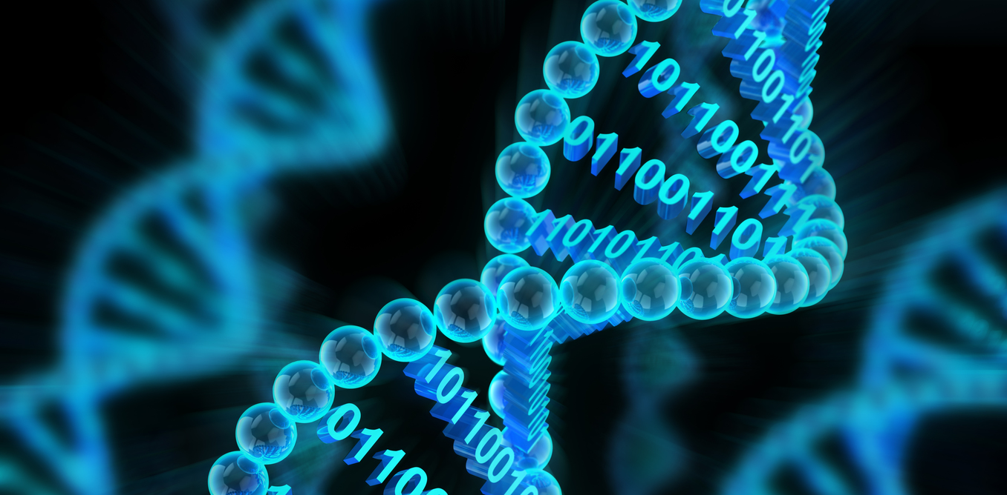



Data Driven Precision Oncology
Prof Aedin Culhane,
Limerick Digital Cancer Research Centre
@AedinCulhane Aedin.Culhane@ul.ie

Slide 2
Overview of talk
Briefly introduce computational oncology and our lab
eHealth -Hub for Cancer
Recent work
CAR T-Cell in renal cancer. Wang et al., Mol Ther Oncolytics 2021
Sensitivity to NK cell killing. Scheffer et al., Nat Genet. 2021
GVHD and tissue resident cells (unpublished)

Slide 3
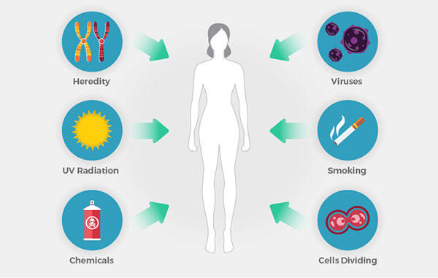
Understanding cancer integrates data
Genetic changes
cause or increase the
risk of cancer
1 in 2 people affected

Slide 4
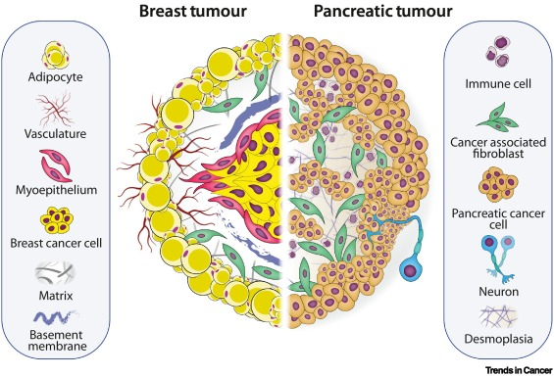
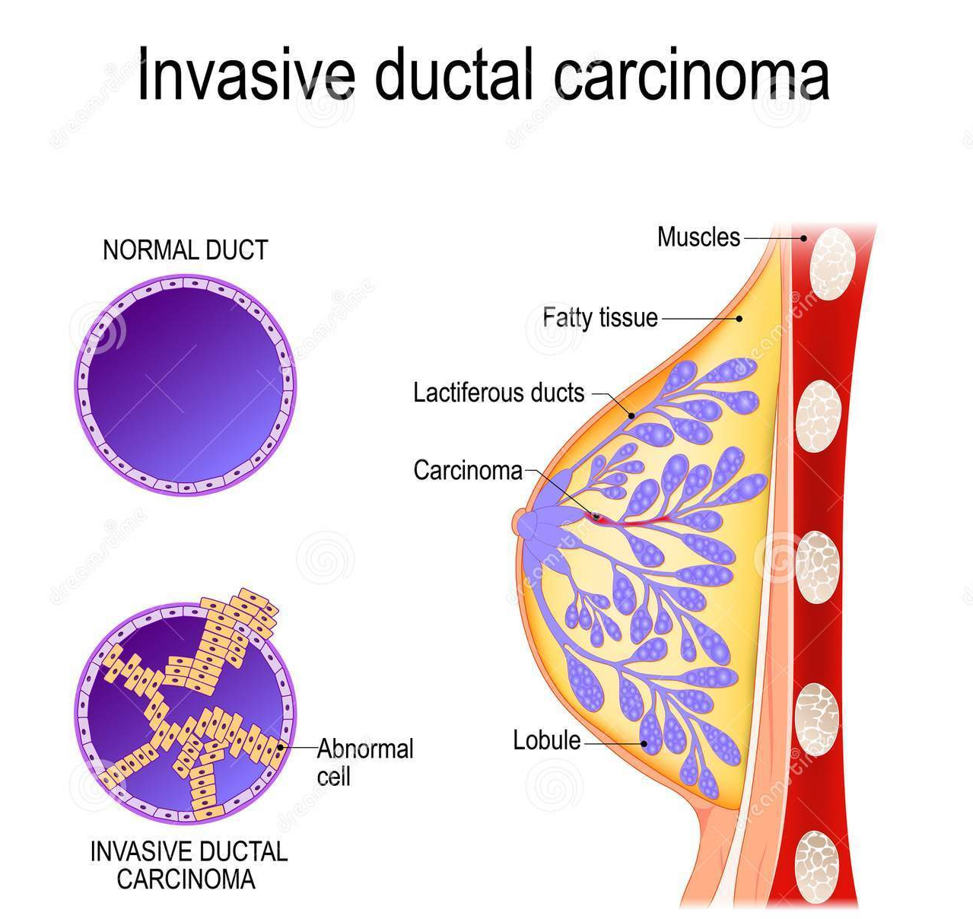
Complexity of cancer : molecular basis of multicellular disease
Human disease occurs within a complex milieu of cells
Multiple body systems are involved in disease response;
immune, lymph, nervous, endocrine
Disease response involves local and systemic signalling and local tissue effects
Harnessing the immune system
Figure from Carter et al., 2021, Trends in Cancer 7:11
Notes:
To build multi-cellular predictions of drug efficacy v side effects

Slide 5
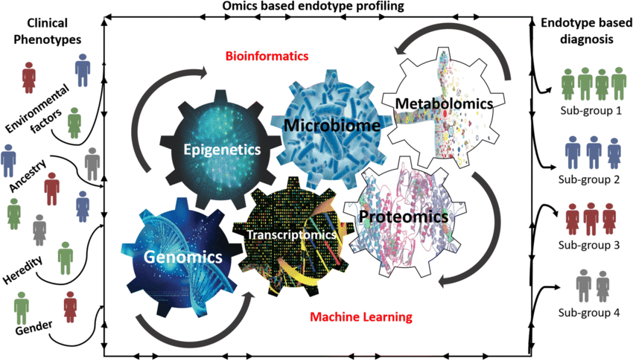
Computational Oncology
Transcriptomics
Germline and somatic DNA changes
Epigenetics
Microbiome
Metabolomics
Integration with EHR
Longitudinal, case/control, preclinical or phase I trial
Multi’ omics integration

Slide 6
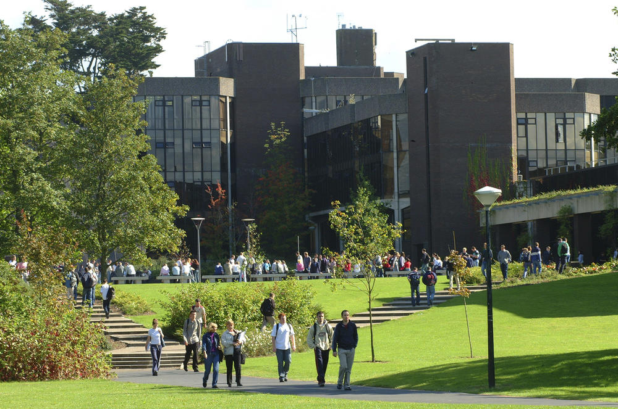
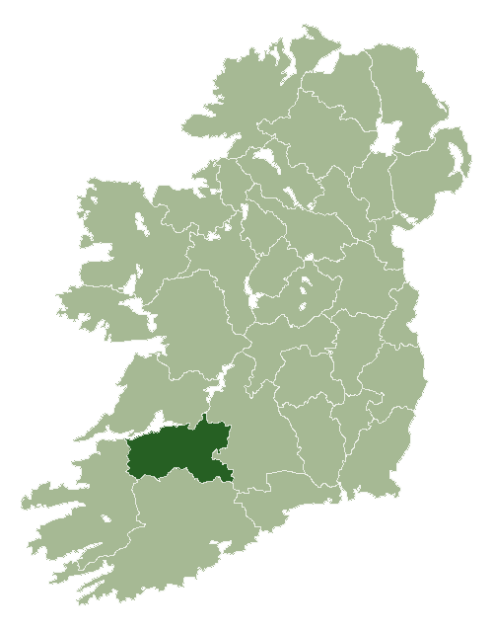







Drawing on the collective expertise and resources of partners who have seen recent research investments totalling more than €300 million to develop digital personalised medicine to transform Cancer Care.

Slide 7
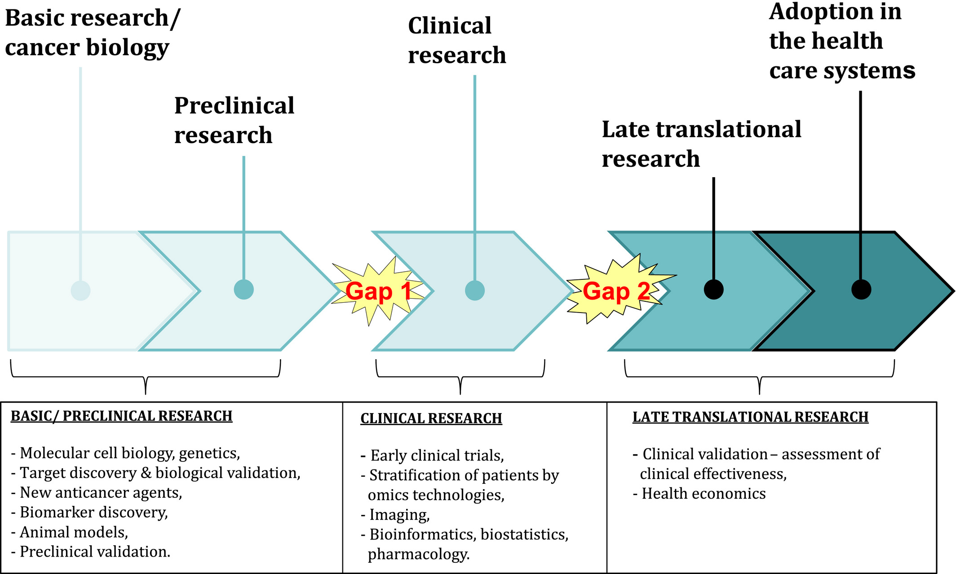
Phase 0/1 clinical trial pipeline
Basic Research (Preclinical)
Phase I Trials
Phase II/III Trial
Clinical Care
Pre NGS
Celis, J.E. and Pavalkis, D. (2017), A mission-oriented approach to cancer in Europe: a joint mission/vision 2030. Mol Oncol, 11: 1661-1672. https://doi.org/10.1002/1878-0261.12143

Slide 8
Data Rich in Clinical Oncology Research
Clinical RWD Research
Data Science
Clinical Trials or basic lab research
Clinical Real World Data
Clinical & Preclinical Genomics, Data Science & Bioinformatics
Phase I Clinical Trials
Basic Lab Preclinical
Clinical NGS
Data Science & Bioinformatics
Basic Research pre-clinical
Basic Research (Preclinical)
Phase I Trials
Phase II/III Trial
Clinical Care

Slide 9
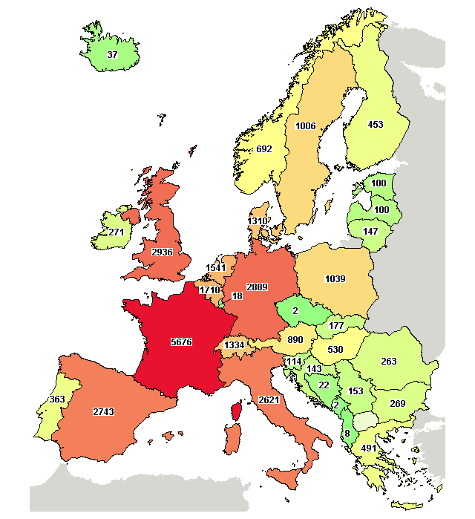
Recruitment to Clinical Trials in Ireland
Patients have been shown to have significantly better outcomes by taking part in clinical trials.
Clinical trials enhance the value proposition for innovation and help us to attract global investments
But 2/3 Irish patients not offered CCT (Kearns et al., 2020). Lack access to structured routine care clinicogenomic data that can predict trial outcomes (Singal et al., 2019)
Lack of digital health data impediment to CCT
www.ipha.ie, Nov 11, 2020
https://clinicaltrials.gov/

Slide 10
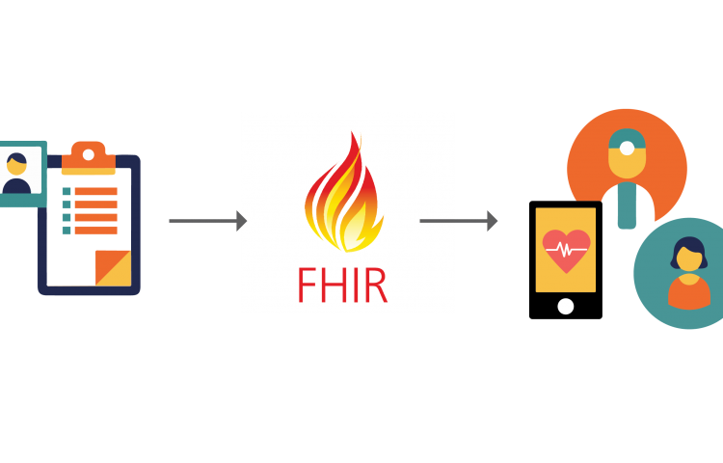

Skills for Interoperable, Real-time, Real-World Data
eHealthHub
Strand II All-Island programme in federated eHealth cancer research awarded €4 million from the Shared Island Unit

Slide 11
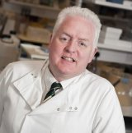











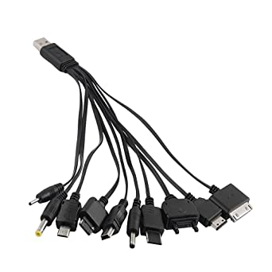











eHealthHub
Mark Lawler (QUB)
Heterogeneous
Irish Data
Common
Data Standard
Aedin Culhane (UL)
4 Million Euro
10 PhD Students
4 Post doctoral Fellow
7 Research Assistants
eHealthHub

Slide 12
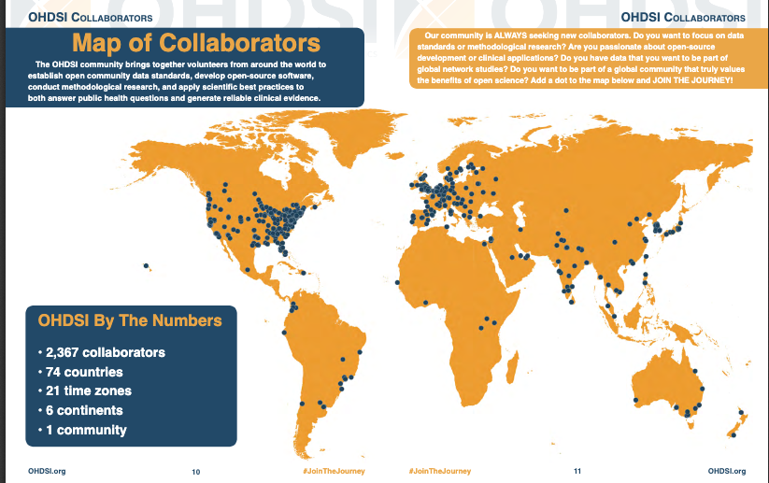


Interoperability, Standards
>800 Million EHR mapped
to a standard format
Observational Medical Outcomes
Partnership (OMOP)
Common Data Model (CDM)
Health Level 7 International Version 2
Fast Healthcare Interoperability Resources

Slide 13



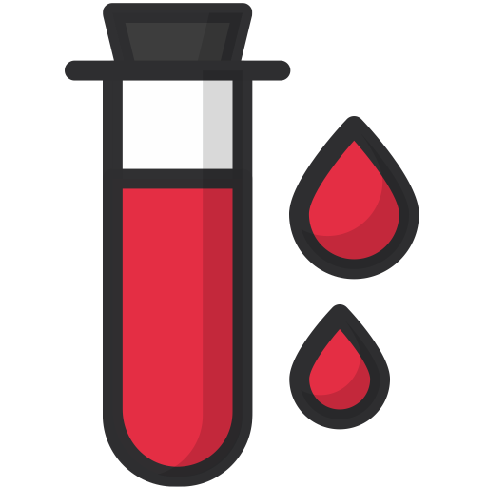

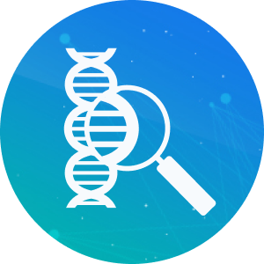


Digital Data in Cancer EHR
á
Patient history
Co-morbidity
Drugs, treatments history
Pathology
Digital Pathology
Germline Genetics, family risk
Genomics
Blood tests (liquid biopsies)
Immuno-oncology
Mobile Apps -eg boutros bear
EHR medical
profile
Family History
Genetics
Environment
Data
Integration &
Modelling
Liquid Biopsies
Proteomics
Digital
Pathology
sequencing
Metabolites
Single Cell
Organoid
Humanized Models

Slide 14







Cancer Digital Health
á
Data Science
EHR medical
profile
Family History
Genetics
Environment
Data
Integration &
Modelling
Liquid Biopsies
Technology
Proteomics
Digital
Pathology
sequencing
Metabolites
Single Cell
Organoid
Humanized Models
Federated
learning
Cloud
computing
Connected
devices
AI/ML

Slide 15
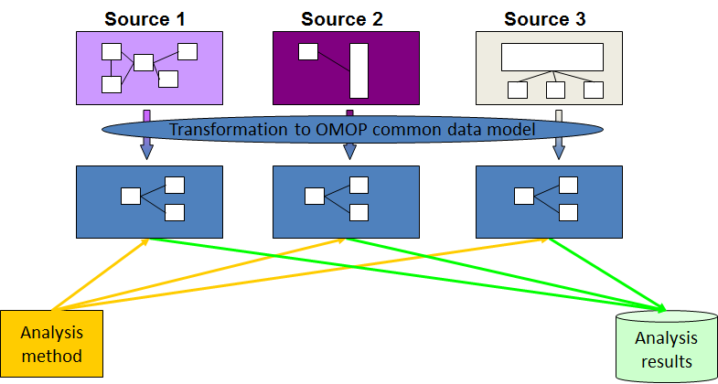
What's so important about standards
Data source (EHR) is held locally within each site
Researchers can query internal database
Limited silos of data is a problem.
Studies are underpowered especially in rare disease
X
X
X
Unable to “Communicate”

Slide 16
What's so important about standards
Data can be locally secure
but globally accessed
Query can be sent to each data source
Summarized results (not data) returned
Aggregated over many
X
X
X
X
X
Unable to “Communicate”

Slide 17
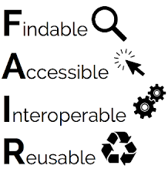
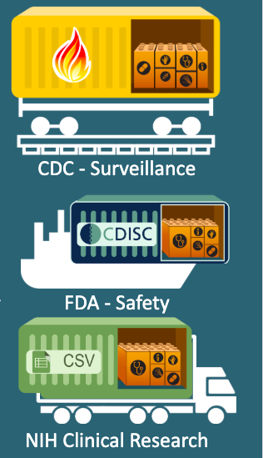
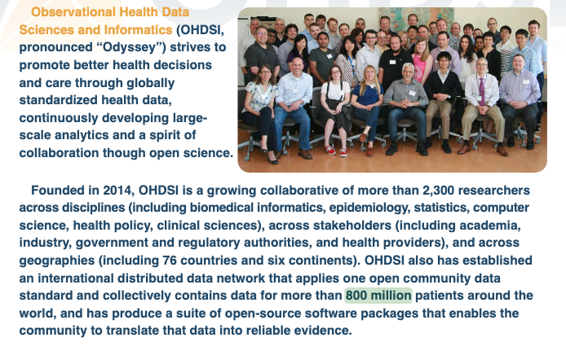
Real-time, Real-World Data
EHR Insurance & medical records, inpatients, outpatient and GP data mapped to a common format provide
Real-time, real-world surveillance and research

Slide 18
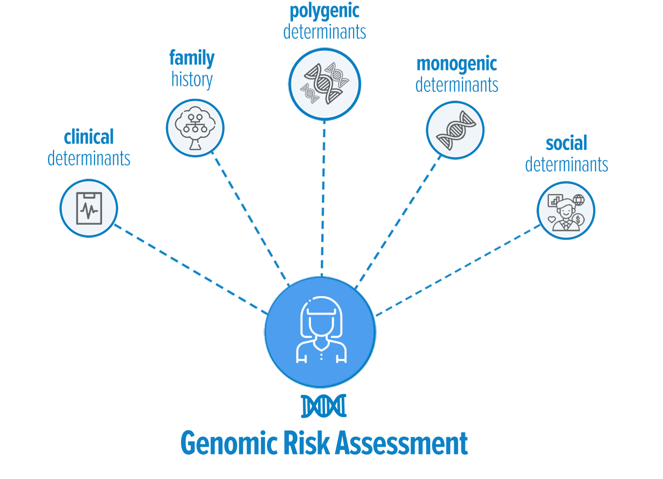
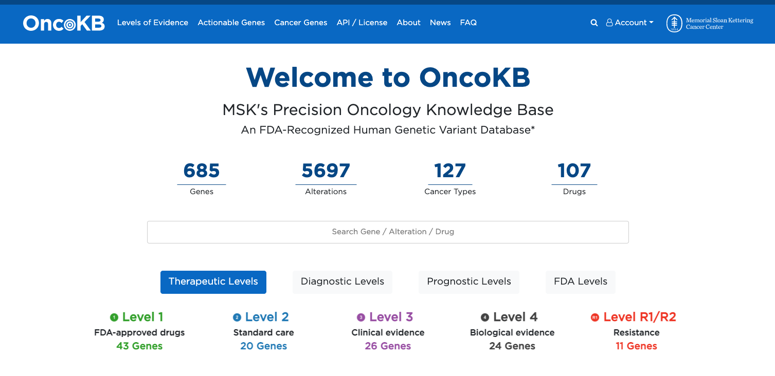

Clinically actionable genes in EHR
https://www.nature.com/collections/ccigjichjc/

Slide 19
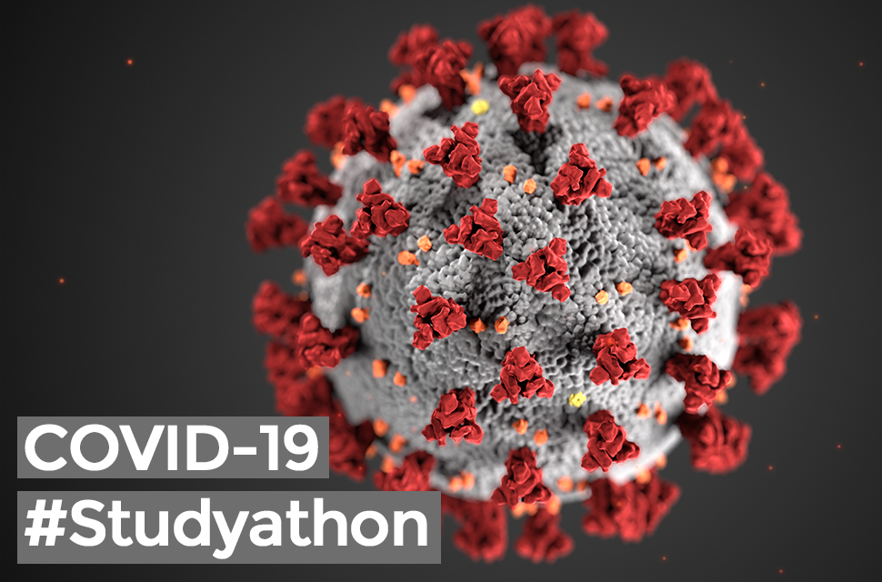
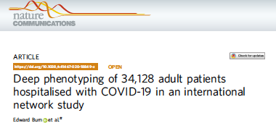
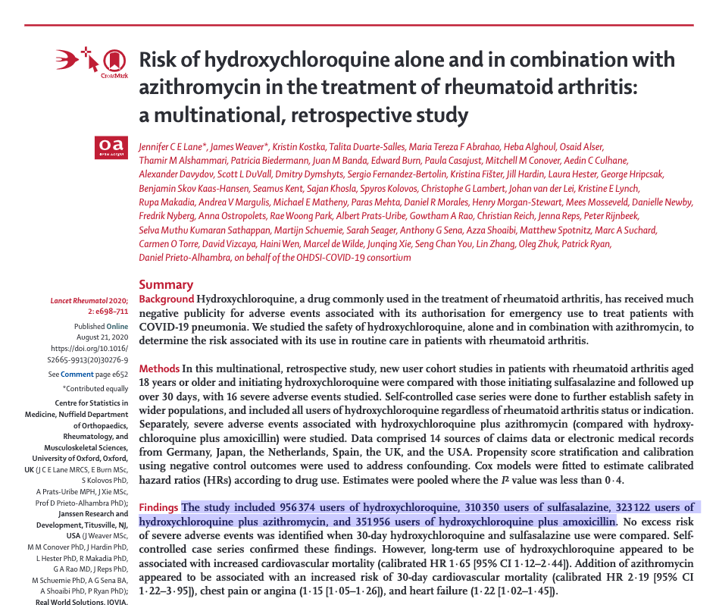
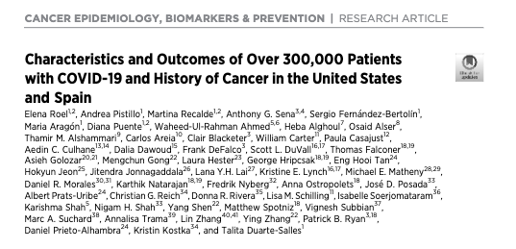

Our RWD research impact during COVID-19
956,374 patient records

Slide 20
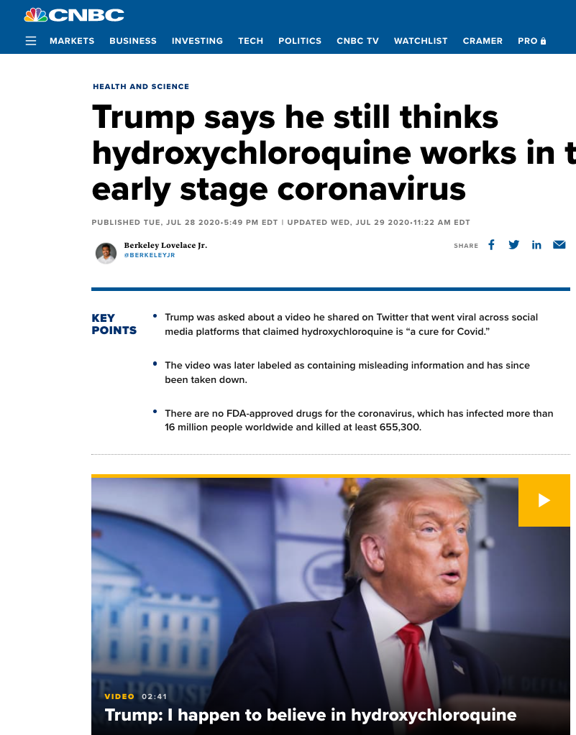
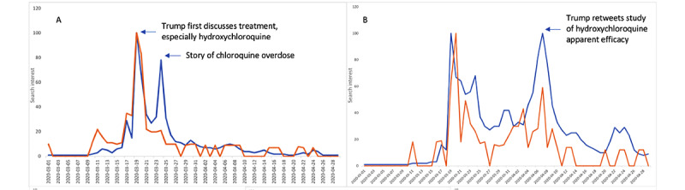
Hydroxychloroquine and COVID-19
From March 1 to April 30, 2020, Donald J Trump made 11 tweets about unproven therapies and mentioned these therapies 65 times in White House briefings, especially touting hydroxychloroquine and chloroquine
Google searches (blue line) Purchases (orange line)
J Med Internet Res. 2020 Nov; 22(11): e20044.

Slide 21
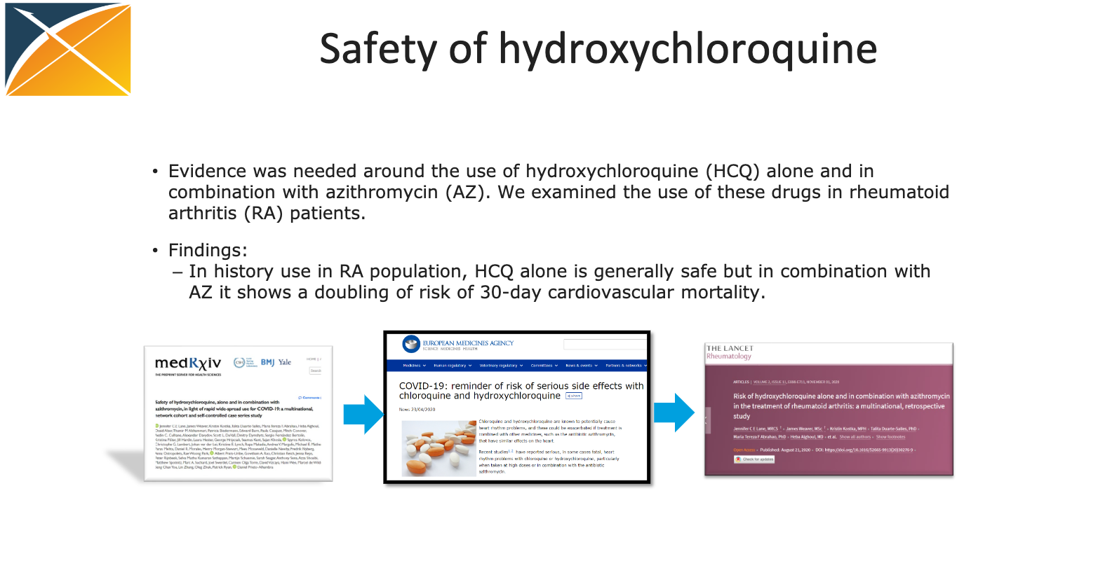
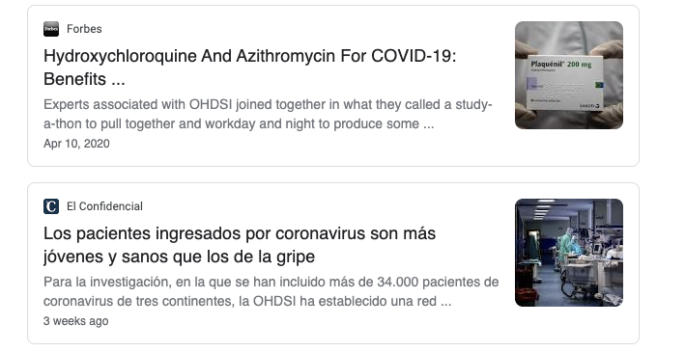
Study-a-thon
March 26-29th
Initial draft
April 10th 2020
Aug 21st 2020
April 23rd 2020
EMA Recommendation
REAL WORLD IMPACT FROM RWD

Slide 22
Data Driven Clinical Oncology Research
Clinical RWD Research
Data Science
Clinical Trials or basic lab research
Clinical Real World Data
Clinical & Preclinical Genomics, Data Science & Bioinformatics
Phase I Clinical Trials
Basic Lab Preclinical
Clinical NGS
Data Science & Bioinformatics
Basic Research pre-clinical
Basic Research (Preclinical)
Phase I Trials
Phase II/III Trial
Clinical Care

Slide 23
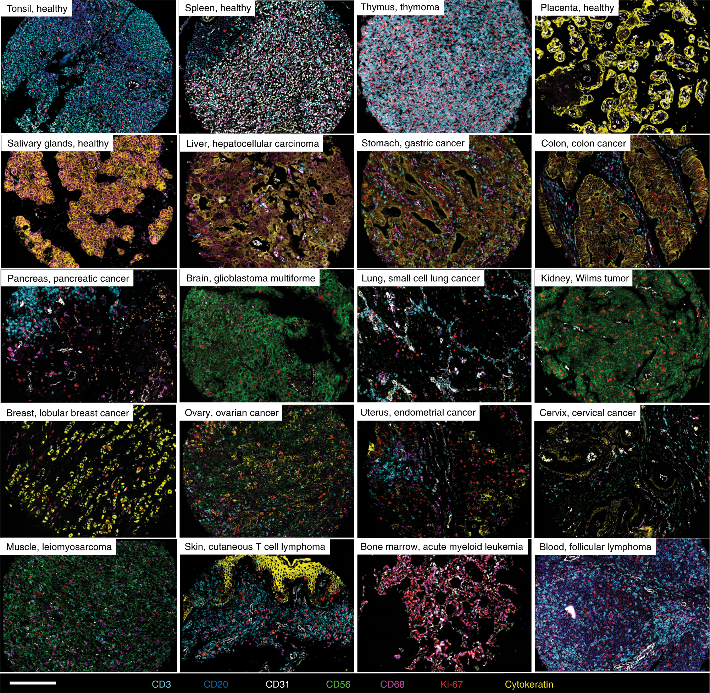
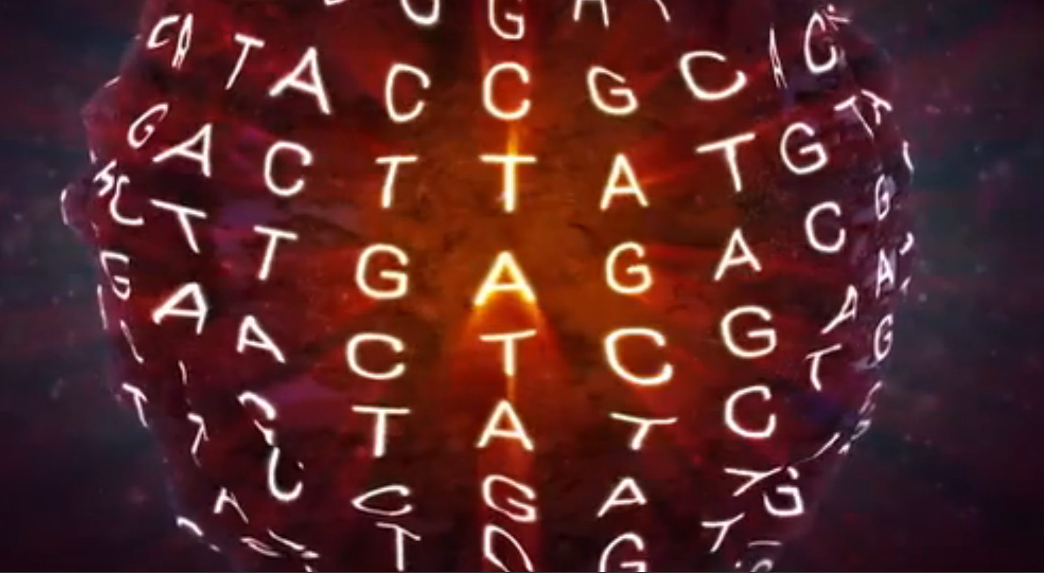
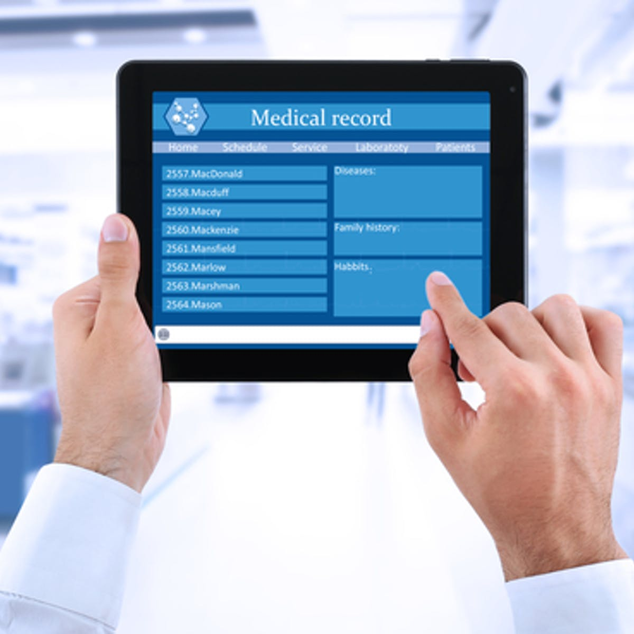
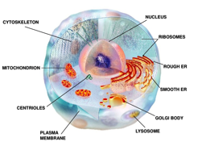
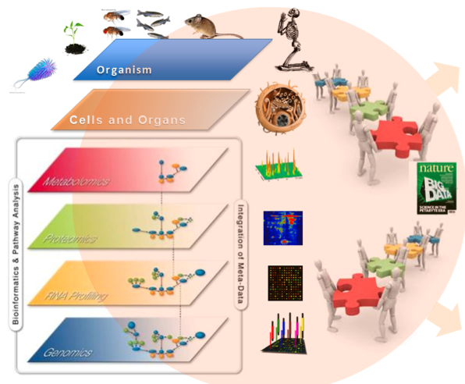
Culhane lab- Computational Oncology model that integrate multi modal data

Slide 24
Complexity of cancer : molecular basis of multicellular disease
Human disease occurs within a complex milieu of cells
Multiple body systems are involved in disease response;
immune, lymph, nervous, endocrine
Disease response involves local and systemic signalling and local tissue effects
Harnessing the immune system
Figure from Carter et al., 2021, Trends in Cancer 7:11
Notes:
To build multi-cellular predictions of drug efficacy v side effects

Slide 25
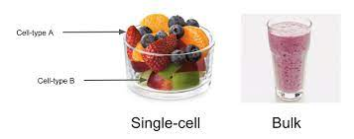
Tremendous Technology Advances in <5 years
Average of cell mixture
biopsy (pre-2020)
Spatial single cell measurements (post 2020)

Slide 26
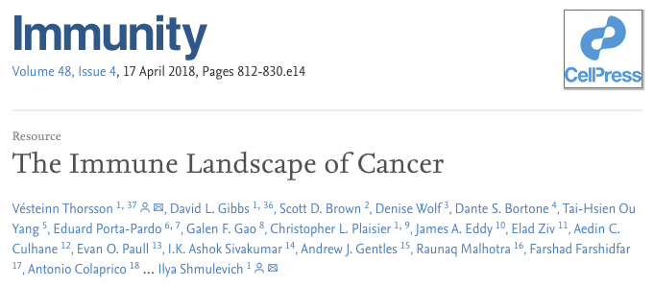
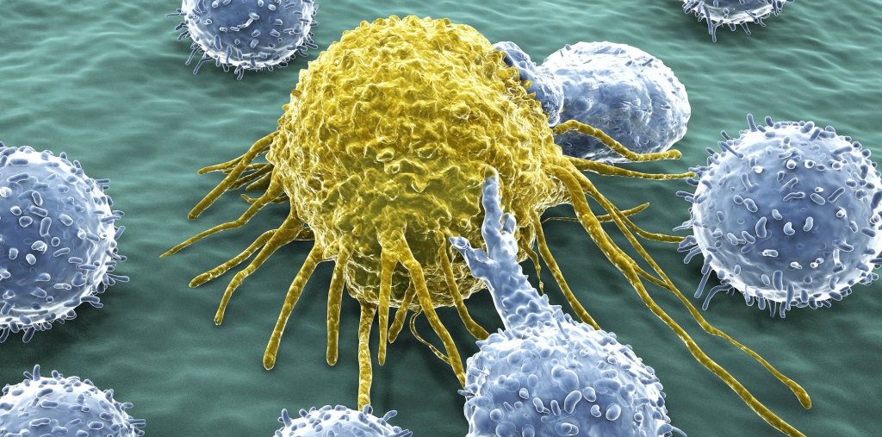
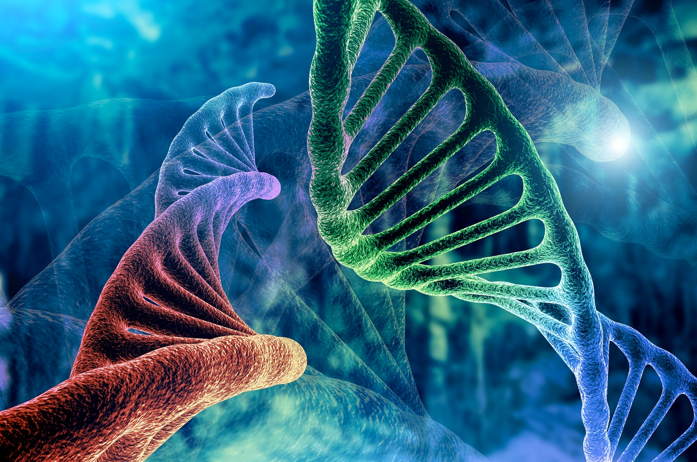
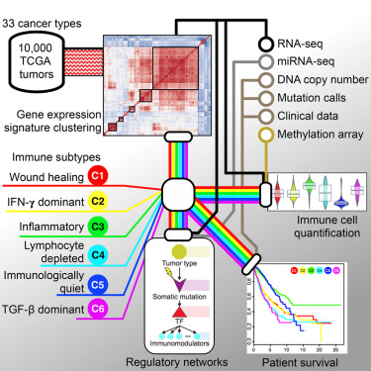
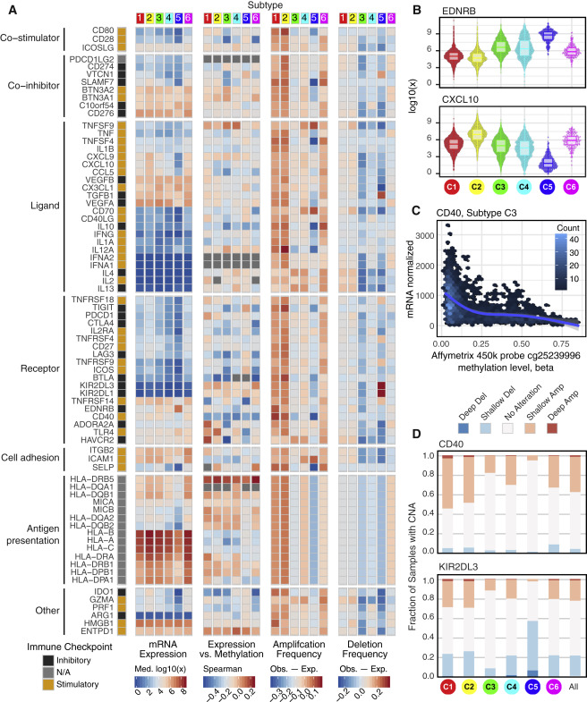
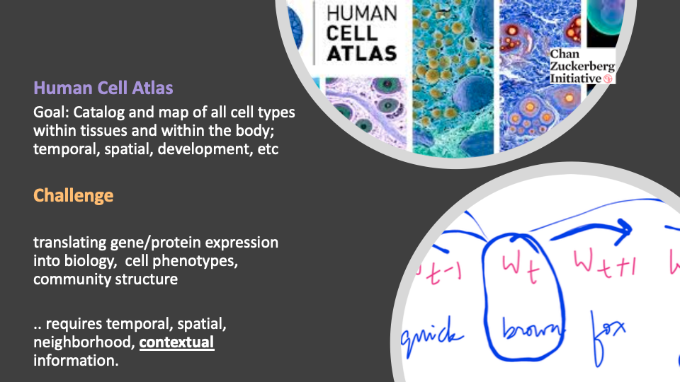
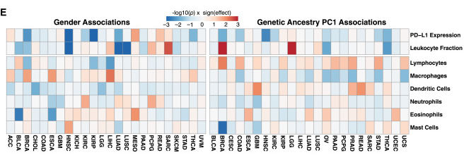
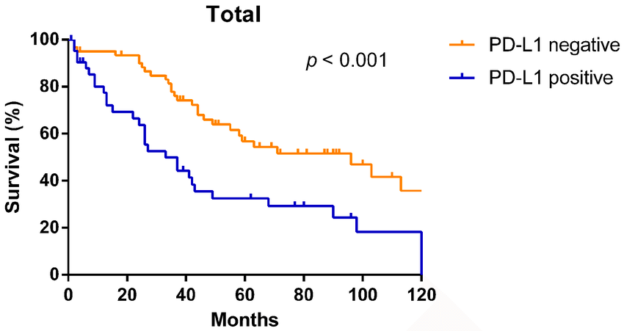
> 10,000 tumors comprising 33 diverse cancer types (TCGA). Across 6 immune types pan-cancers

Slide 27

Creating a Human Cell Atlas
catalog and map of all cell types to the location within tissues and within the body; temporal, spatial, development

Slide 28
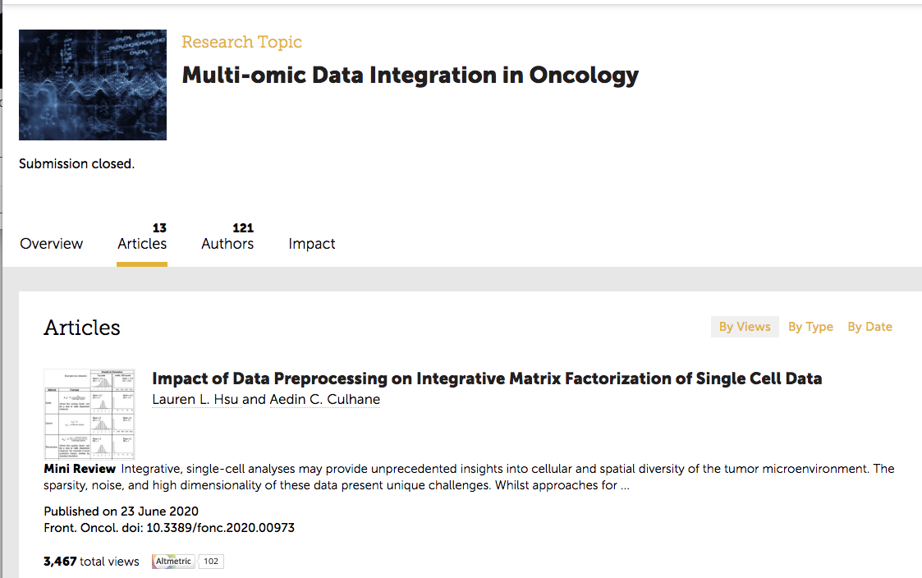
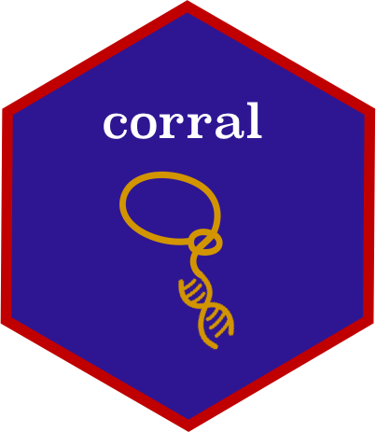

Hsu & Culhane corral: Single-cell RNA-seq dimension reduction, batch integration, and visualization with correspondence analysis bioRxiv 2021.11.24.469874;

Slide 29
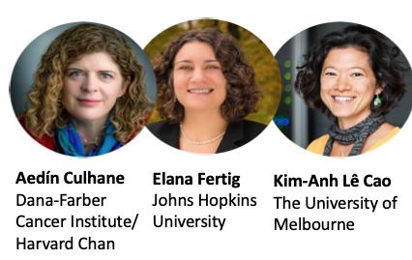
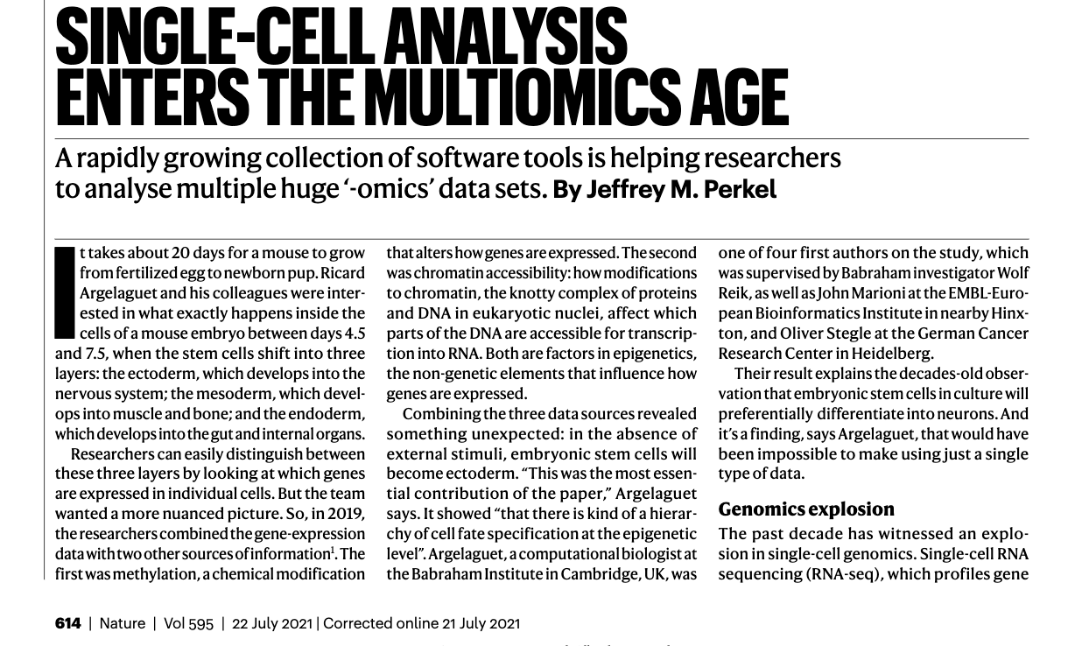
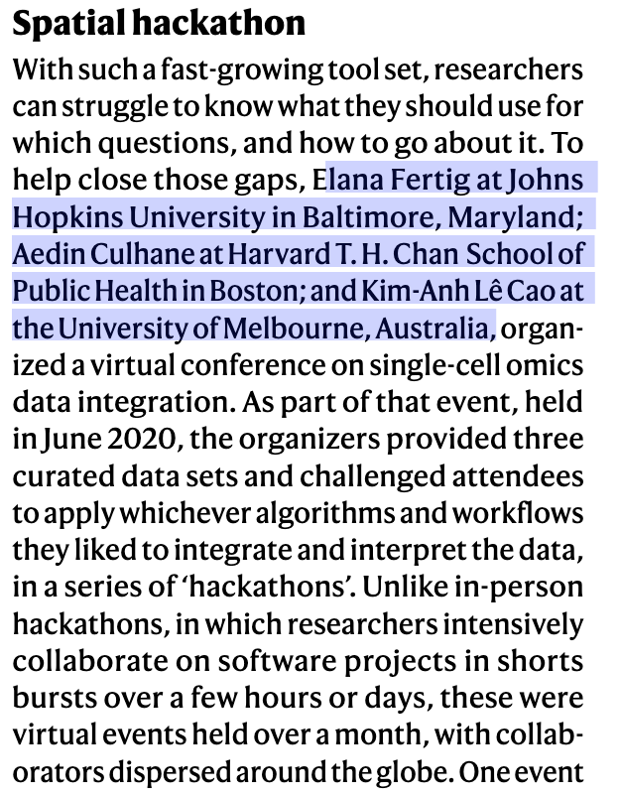
https://www.nature.com/articles/d41586-021-01994-w

Slide 30

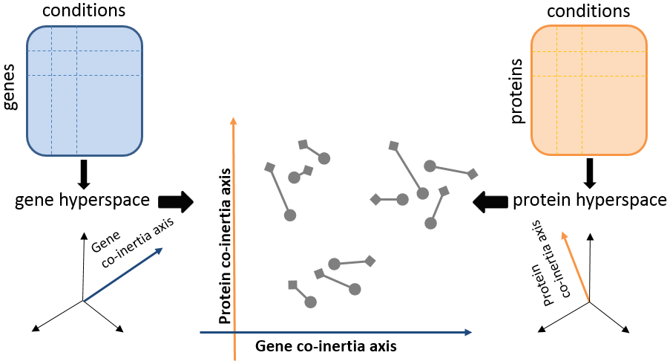
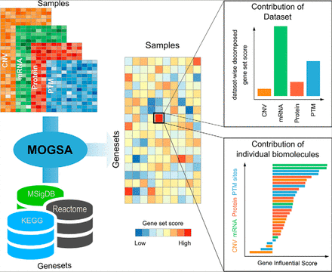





Culhane lab- Multi Modal, Multivariate analysis Matrix Factorization
Global >1,000,000 downloads in 2021

Slide 31
Overview of talk
Briefly introduce computational oncology and our lab
Two recent papers
CAR T-Cell in renal cancer
Sensitivity to NK cell killing
GVHD and tissue resident cells
eHealth -Hub for Cancer

Slide 32


Next generation CAR T-Cells therapies
Recognizes Tumor Antigen
Attacks Tumor
(Signalling)
The most frequently used intracellular domains are derived from
- The CD28 family (CD28 and ICOS)
- The TNF receptor family (4-1BB, CD27, and OX40).

Slide 33



No 1st-generation CARs (poor persistence in vivo)
2nd -generation (28z and BBz) CARs
3rd-generation CAR (28BBz)

Slide 34


scRNAseq comparing 2nd, 3rd Generation CAR T-Cells therapies in ccRCC

Slide 35

2. Towards NK cell therapy
Rapidly evolving interest in engineered NK cells for tumor immunotherapy
“infusions of allogeneic NK cells can be safely performed across human leukocyte antigen (HLA) barriers and avoid the graft-versus-host reactions that are an inherent challenge for immunotherapies based on administration of allogeneic T cells”
Scheffer et al., 2021 Nat Genet. 2021 Aug;53(8):1196-1206.

Slide 36


NK Cell Killing

Slide 37

B7H6 is essential for NK cell killing
High B7H6 important for NK killing sensitivity

Slide 38

Tumor Immune Environment –NK cells
NK cell sensitive tumor cells
chromatin remodeling
‘mesenchymal-like’ transcriptional programs
high B7-H6 (NCR3LG1)
low levels of HLA-E/antigen presentation genes.
NK cell–sensitive tumor cells correlate with immune checkpoint inhibitor (ICI) resistance in clinical samples.

Slide 39



PDL1/PDL2 family
(treefam TF331083)
BTNL3, BTLN8#
BTN3A1, BTN3A2, BTN3A3#
Butyrophilins
BTN2A1, BTN2A2, BTN1A1 #
MOG
BTN/BTNL
Cluster
Cluster of rodent
SKINT proteins
B7H6 is a B7 protein
In the same family as PD-1, and CTLA4
Gene ancestor
BTNL2
B7H7 (HHLA2)*
PDL1, PDL2
Cluster
B7H4 (VTCN1)
PDL2 (PDCD1LG2, CD273)
PDL1 (CD274)
B7H6 (NCR3LG1)*
human
rat
CD276
Cluster
B7H3 (CD276)
mouse
chicken
B7.2 (CD86)
B7.1 (CD80)
fish
B7H2 (ICOSLG, CD275)

Slide 40

Why haven’t we heard about B7-H6 before?
PDL1
PD1
PDL2
B7 Genes
With no or few Rodentia paralogues
Outgroup
(Lizard/Fish/
Platypus)
Unpublished
Rodents
Primates

Slide 41


3. Tissue resident immunity and GVHD
1. Pre-transplant skin
2. Pre-transplant blood
3. Post-transplant skin
4. Post-transplant blood
scRNAseq and TCR seq
Pre/Post transplant
Blood, Tissue from Receipt and Donor

Slide 42

Tissue Specific of B7 genes
ROC sensitivity/specificity to identify genes that differentiated different tissues. Most immune genes had high specificity for blood, spleen, small intestine, lung.
PDL2
PD1
PDL1
Tissue specificity + evolution/GWAS can be used to deliver personalized IO
B7H6
Unpublished

Slide 43
Summary
Importance of computational oncology and our lab
Framework for sharing health data for research -eHealth -Hub for Cancer
Single Cell Genomics and Immuno-Oncology Research
CAR T-Cell in renal cancer. Wang et al., Mol Ther Oncolytics 2021
Sensitivity to NK cell killing. Scheffer et al., Nat Genet. 2021
GVHD and tissue resident cells (unpublished)

Slide 44













Questions
@AedinCulhane
Aedin.Culhane@ul.ie
Tools and methods to analyse single cell data
Corral, Hsu & Culhane, 2021
Bioconductor Eckenrode et al, 2021
Hackathon Le Cao et al., 2021
Real-world data (COVID-19 Study-a-thon)
Roel et al. 2021,
Lane et al, 2020,
Burns et al. 2020
TME immune, stroma cells in cancer
Wang et al., 2021,
Dhimolea et al., 2021,
Sheffer et al., 2021

